Slide 1
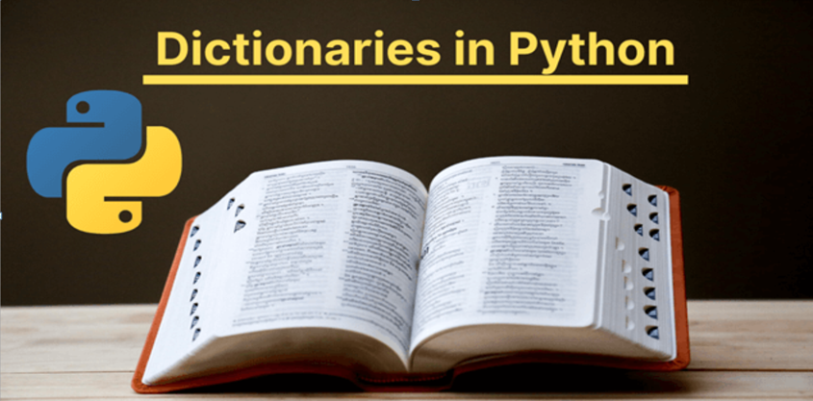
By: Piyush Vashistha

Slide 2
Dictionary
Dictionary is Mutable.
Elements are arranged in the form of key-value pairs.
The symbol used to represent Dictionary is {}
eg. d=:{‘Aman’:6.7, ’Raj’:9.5, ’Madhav’:8.6}
key value
Key and its value is separated by a colon :

Slide 3
Keys must be immutable (may be string, tuple, number).
Values may be immutable or mutable.
General syntax of dictionary is as follows:-
d={key1:value1,key2:value2,…….keyn:valuen}
Elements are not ordered.
It does not have the concept of numeric indexing, but it has the concept of key indexing.
eg. print(d[key])

Slide 4
Q1. How we can create empty dictionary?
Ans. d={}
OR
d=dict()

Slide 5
Accessing Values
d={‘Aryan’:8.5, ’Madhav’:9.5, ’Dev’:6.5}
print(d[‘Aryan’])
print(d.get(‘Dev’))
print(d[‘madhav’])
O/P: 8.5
6.5
Error

Slide 6
Dictionary is Mutable
Adding elements in Dictionary
d[key]=value
d1.update(d2)- Adds the elements of d2 to the elements of d1.
d1={‘Aman’:6.2, ‘Ajay’:8.2}
d2={‘Madhav’:5.5, ‘Manav’:6.6}
d1.update(d2)

Slide 7
Deleting elements from dictionary
d.pop(key [, defaultvalue]) :- In this, it will delete the key-value pair based on provided key.
2nd parameter is optional, If it is there, it will return if key does not exist.
d.popitem() :- It removes the item that was last inserted into the dictionary. In versions before 3.7,it removes a random item.
The removed item is the return value in the form of tuple.

Slide 8
d.clear() :- It will empties the dictionary.
del d[key] :-It will delete the key-value pair based on key.

Slide 9
Modifying the value of dictionary
d[key]=value

Slide 10
Methods of Dictionary
d.copy()
d.get(key[,value]): To access value of dictionary.
d.keys():- It will give list of all keys present in dictionary.
d.values():-It will give list of all values present in dictionary.
d.items():- It will give list of all keys,values present in dictionary. Return List of tuples.
d.has_key(key):-It works in Python 2.x version.
Use in operator in Python 3.x

Slide 11
d.fromkeys(seq[,value]):- This will help in creating a dictionary
d.setdefault(key,value)
len(d)
sorted(x):- x may be d.keys() or d.values()
zip(l1,l2) :
dict()

Slide 12
Looping over a Dictionary
d={‘amit’:6.5, ‘raj’:9.1,’madhav’:7.8}
for i in d:
print(i)
for i in d:
print(i,’ ‘,d[i])
for i, j in d.items():
print(i,’ ‘,j)
for i in d.items():
print(i)

Slide 13
Dictionary Comprehension
d={i:i*i for i in range(10)}
D={x:2*x for x in range(1,5)}

Slide 14
Programs
1.WAP that creates a dictionary of radius of a circle and its circumference.
Expected O/P: Enter -1 to exit
Enter radius:5
Enter radius:7
Enter radius:8
Enter radius:-1
{5:31.4, 8:50.24,7:43.96}

Slide 15
2.WAP that prints the histogram of frequencies of characters occurring in a message.
Expected O/P: Hello Hi
H **
e *
l **
o *
*
i *

Slide 16
3. WAP to invert the dictionary( i.e keys becomes values and vice-versa)
4.WAP that has dictionary of names of students and a list of their marks in 4 subjects. Create another dictionary from this dictionary that has name of the students and their total marks. Find out the topper and his/her score.

Slide 17
5. Write a Program to store a sparse matrix as a dictionary.
Assume Sparse Matrix
0 1 2 3 4
0 0 0 0 1 0
1 2 0 0 0 3
2 0 0 0 4 0
Expected O/P:
Sparse Matrix represented as dictionary:
{(0,3):1, (2,3):4, (1,0):2, (1,4):3}

Slide 18
6. WAP that prompts the user to enter a message. Now count and print the number of occurrences of each character.
7. WAP that creates a dictionary of cubes of odd numbers in the range 1-10.
8. WAP that enter string and then find the frequency of each word and represent in the form of dictionary.

Slide 19
Nested Dictionary
OrangeCap Example
(Find Top-Scorer along with score)
D={ 'match1':{ ‘Virat':57, ‘Dhoni’:38 },
'match2':{ ‘Maxwell':9, ‘Virat':42 },
'match3':{ ‘Dhoni':41, ‘Taylor':63, ‘Maxwell’:91 } }

Slide 20
Solution
D={ 'match1':{ 'Virat':57, 'Dhoni':38 },
'match2':{ 'Maxwell':9, 'Virat':42 },
'match3':{ 'Dhoni':41, 'Taylor':63, 'Maxwell':91 } }
x=D.values()
D1={}
print(x)
for i in x:
for j in i:
if j in D1:
D1[j]=D1[j]+i[j]
else:
D1[j]=i[j]
print(D1)
k=max(D1,key=D1.get)
print("Player Name is ",k)
print("Score is ",D1[k])

Slide 21
Some More Programs…..
1. WAP that has a dictionary of words in English Language and their corresponding words in Hindi. Define another Dictionary that has a list of words in Hindi and their corresponding words in Urdu. Take all words from English Language and display their meaning in both the languages.
d1={‘Teacher’:’Shikshak’, ‘Book’:’Pustak’,’Friend’:’Mitr’}
d2={‘Shikshak’:’Adhyapak’,’Pustak’:’Kitab’,’Mitr’:’Dost’}
Expected O/P:
Teacher in Hindi means Shikshak and in Urdu means Adhaypak
Book in Hindi means Pustak and in Urdu means Kitab
Friend in Hindi means Mitr and in Urdu means Dost

Slide 22
2. WAP that creates two dictionaries. One that stores conversion values from meters(1-5) to centimeters and other that stores values from centimeters to meters.
Expected O/P:
Meters to Centimeters
{1:100,2:200,3:300,4:400,5:500}
Centimeters to Meters
{100:1,200:2,300:3,400:4,500:5}

Slide 23
3.WAP that has a dictionary of states and their codes. Add another state in the pre-defined dictionary, print all the items in the dictionary and try to print code for a state that does not exist. Use setdefault() method
states={‘Rajasthan’:101,’Haryana’:102}
Expected O/P:
{‘Rajasthan’:101,’Haryana’:102,’Assam’:103}
None
{‘Rajasthan’:101,’Haryana’:102,’Assam’:103,’Goa’:104}

